Slide 1
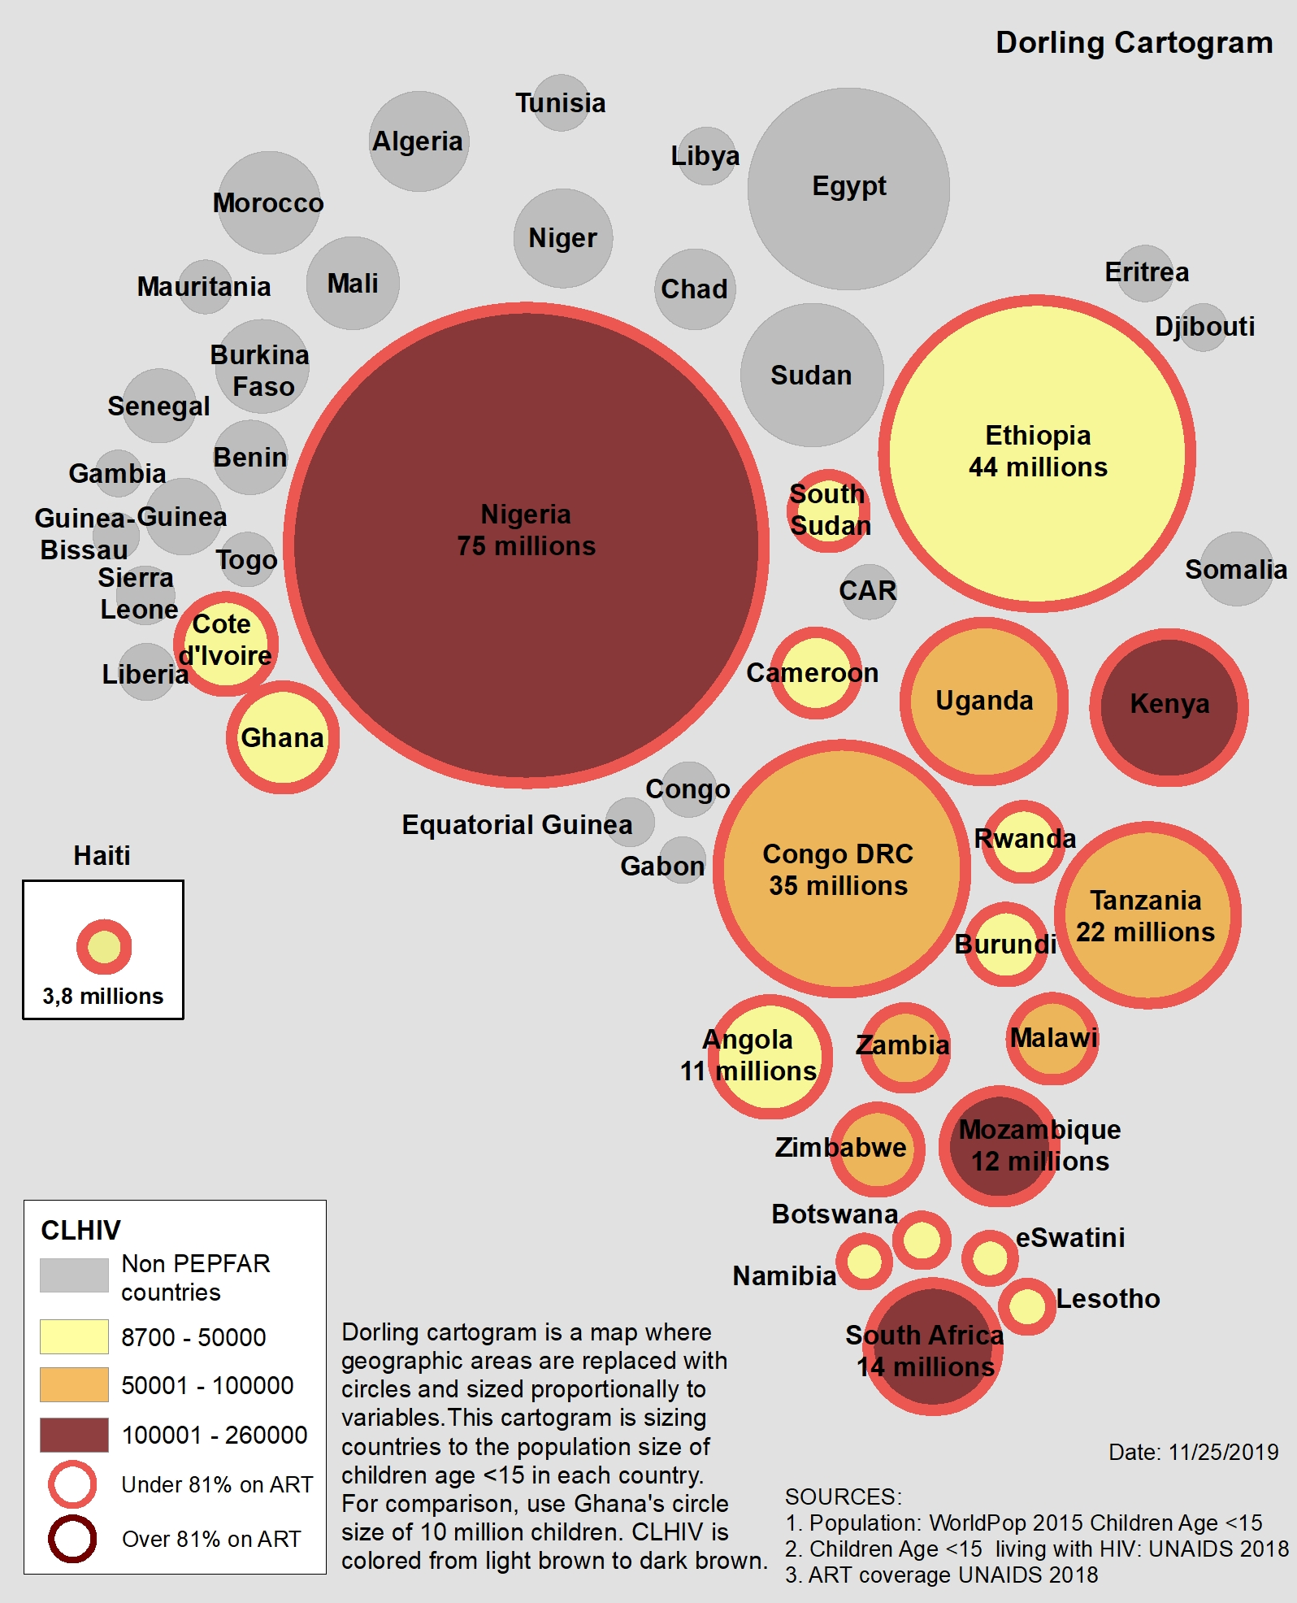
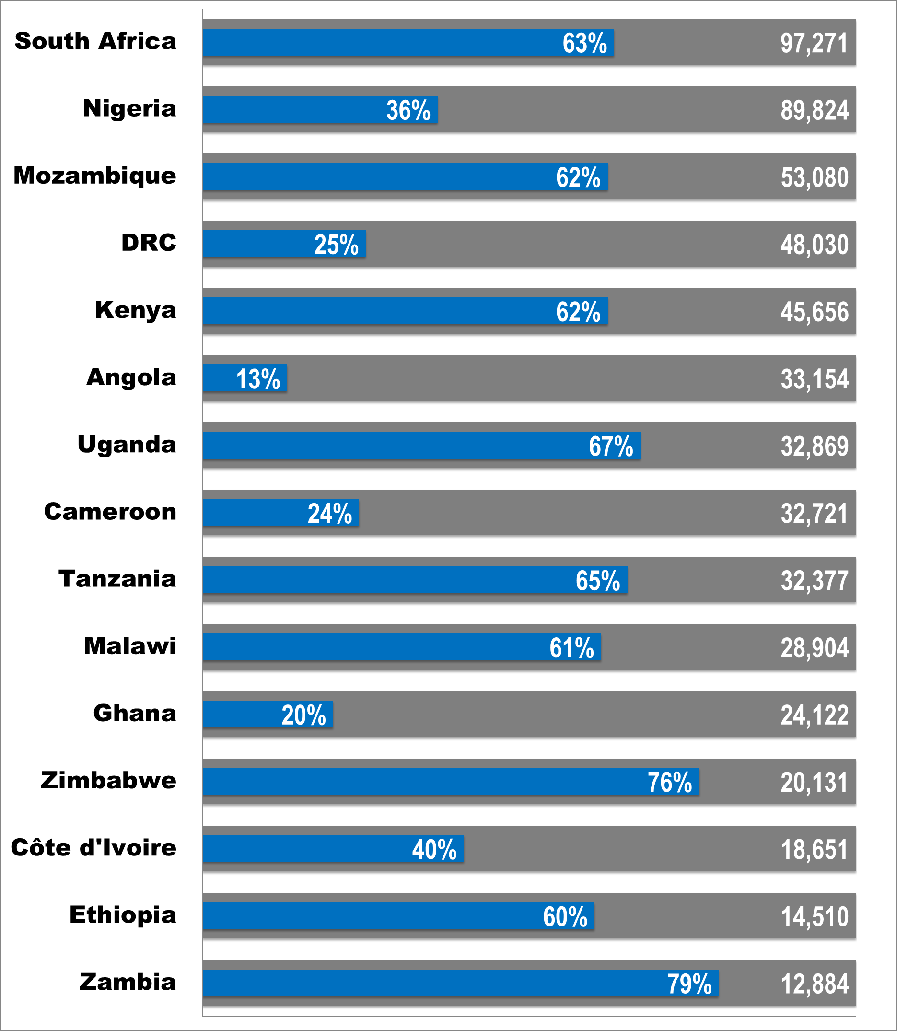
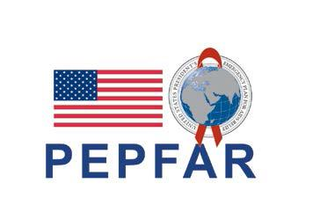
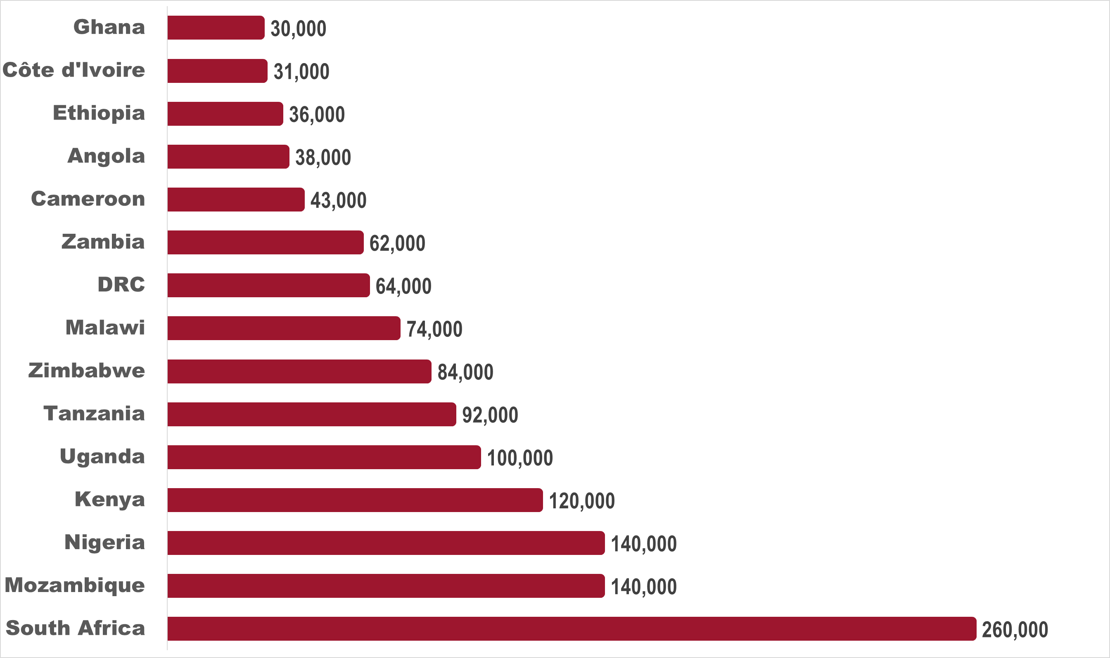

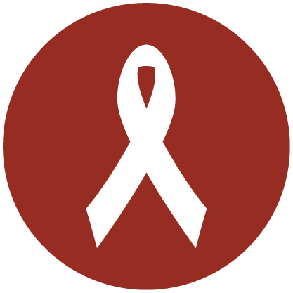
Where are the Children? A Geo-Spatial Look at Children Living with HIV and on Treatment in PEPFAR-Supported Programs: 2017 – 2018
Abstract #THPEB081
KaeAnne Parris, MPH¹, Zhanar Haimovich, MA², Patricia Agaba, BmBcH³, ⁴, James Tobias, MS², Amy Emnet Aberra, MPH⁵, Deborah Carpenter, MD, MPH, MBA¹
¹Maternal and Child Health Branch, Division of Global HIV & TB, U.S. Centers for Disease Control and Prevention, Atlanta, GA, USA; ² Northrop Grumman Corporation, Falls Church, VA, USA; ³ U.S. Military HIV Research Program, Walter Reed Army Institute of Research, Silver Spring, MD , USA: ⁴Henry M. Jackson Foundation for the Advancement of Military Medicine, Bethesda, MD, ⁵ United States Agency for International Development, Washington, DC, USA.
Background
Results
Are children on track to reach 90% ART Coverage by 2020?
1.8 million children (0-14 years) are living with HIV (CLHIV) globally.
52% are receiving antiretroviral therapy (ART).
Without treatment, 50% will die before their second birthday and 80% before turning five years old.
The U.S. President’s Emergency Plan for AIDS Relief (PEPFAR) is the largest supporter of CLHIV on ART worldwide.
We describe the burden of pediatric HIV and assess gaps in ART coverage among children aged 0-14 years in 23 PEPFAR-supported countries.
Where do children with HIV live?
Where is the unmet treatment need?
Figure 1. Dorling cartogram of the pediatric population, CLHIV estimates and ART coverage
Figure 3. Unmet Treatment Need and ART Coverage
Methods
Triangulation of WorldPop, UNAIDS Estimates, and PEPFAR MER Indicators
We used multiple data sources to map the 0-14 population, CLHIV burden and ART coverage geographically.
WorldPop
UNAIDS Global AIDS Response Progress Reports
PEFAR HIV Monitoring Evaluation Reporting Indicators
We mapped and developed multi-variate Dorling cartograms for populations 0-14 years, CLHIV, and ART coverage as a percent to show a comprehensive view of pediatric populations by country.
The analysis was limited to 23 PEPFAR-supported countries in Africa and Haiti where most CLHIV reside.
Conclusions
The Dorling technique reveals that CLHIV ART coverage is not based on the 0-14 population size or CLHIV burden.
A strategic shift focusing on data triangulation, alternative mapping and visualization approaches is a novel way to emphasize program shortfalls.
Effective implementation of pediatric screening tools to identify HIV+ children, and utilization of community programs to enroll children into care is paramount in reaching 90% ART coverage for CLHIV.
Geographical analyses can garner more support toward prevention, case finding, treatment initiation and retention for CLHIV to reach the 90-90-90 goals.
The Dorling Cartogram technique represents the size of the pediatric population through the size of the circle, based on geography.
Affiliates / Partners
Results
No countries have achieved 81% ART Coverage
This project has been supported by the US President’s Emergency Plan for AIDS Relief (PEPFAR) through the U.S. Centers for Disease Control and Prevention (CDC)
PEPFAR supported 690,639 children on ART in 2018
The 0-14 population was spatially dispersed with highest numbers in Nigeria, Ethiopia and Democratic Republic of Congo.
CLHIV were spatially concentrated in South Africa, Mozambique, Nigeria and Kenya.
Nigeria and Mozambique (140,000 ea) and South Africa (260,000) had the largest burden of CLHIV
60% median ART coverage for children in 23 PEPFAR-supported countries
Zero of the twenty-three (0%) PEPFAR-supported countries, had over 81% ART coverage, with a range of 9% to 79% in 2018 (South Sudan and Zambia, respectively).
The median number of CLHIV was 38,000 (8,700 – 260,000) in PEPFAR-supported countries.
Which countries have the largest burden of children living with HIV?
Figure 2. Top Fifteen PEPFAR Countries with Children Living with HIV
Contact Info
KaeAnne Parris, MPH
Maternal and Child Health Branch, Division of Global HIV & TB, Centers for Disease Control and Prevention (CDC)
KAParris@cdc.gov
404-804-0261

